Slide 1
Analysis of tourism and fishing industries in Puerto San Carlos, Baja California Sur
March 2016

Slide 2
Table of contents
Context and objectives of the study
Welcome to Puerto San Carlos!
Analysis of fishing in Puerto San Carlos
Analysis of tourism in Puerto San Carlos
How to develop ecotourism in Puerto San Carlos?
How can Pelagic Life bring greater value to the community?

Slide 3
1. Context and objectives of this study

Slide 4
Objectives of this study
Initial problematic: Determine a critical level of tourism to reach a real impact on shark fishing in Puerto San Carlos
Initial observation: increasing tourism in PSC won’t have a direct impact on shark fishing
Shark fishermen are not part of PSC community
PSC’s fishermen don’t feel concerned by issues related to shark fishing
Increasing tourism in PSC will have an indirect impact on shark fishing only under specific conditions:
If tourism is based on marine fauna watching activities as it will raise awareness on overfishing and as it will need fishermen skills
if this ecotourism reaches a large scale so that most of the fishermen feel concerned by the need to fight against overfishing and indirectly prevent shark fishermen to operate locally
Revised problematics for this study:
What is the actual level of fishing in Puerto San Carlos? And espcecially of shark fishing?
How can eco-tourism as a whole be developed in PSC? What would be the economic benefits for the community?
How can Pelagic Life be better integrated in the community of PSC to be part of that eco-tourism development?
What would be the conditions to make that eco-tourism have an impact on local fishermen and ultimately on shark fishing?

Slide 5
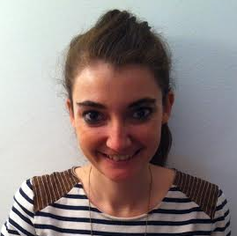
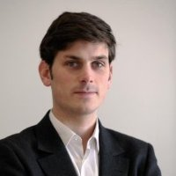
Advise for Change?
French NGO created in 2011 in France.
ww.adviseforchange.com
Providing pro-bono consulting missions to social entrepreneurs
In France, Latin America and South East Asia
10 missions / year in partnership with Ashoka
Consultants: Romain Joly & Amandine de Montvalon
5 weeks project for Pelagic Life (Feb. 19 - March 24 2016) including 3 weeks on the ground in Puerto San Carlos
6 years experience
Public affairs
Strategic communications
ademontvalon@gmail.com
6 years experience
Start-up due diligences
Social innovation projects
jr.romainjoly@gmail.com
Notes:
ROMAIN

Slide 6
WARNING ABOUT THE FIGURES
It was much more difficult to find official figures about Puerto San Carlos that we initially thought. For example, CONAPESCA / SAGARPA local representative in PSC did not want to share any data with us.
All figures in the slides refer to a precise source (in ppt comments) but it is important to differentiate:
figures which come from official sources, mainly figures about Baja California Sur and Comondu
Figures which come from informal sources (student’s thesis and on the ground interviews) that are those we use to analyze Puerto San Carlos’ fishing and tourism industries.
As regards the figures on the value of the fishing industry and the tourism industry ,we calculated them from the information we got on the ground . These are thus estimates so we do not recommend using them in your publications.
The pesos / dollar exchange rate in the following slides is: MXN$18 = USD$1

Slide 7
2. Welcome to Puerto San Carlos: historic and socioeconomic context

Slide 8
Puerto San Carlos in a nutshell
Brief history ¹
Funded in 1967 as a fishing camp known as “Moscú”. In 1968: a decree recognizes the place as a deep-sea, coastal, fishing and sports harbour.
The port was initially built to export agricultural products from neighboring producing regions. Fishing industry rises after the colapse of agriculture with many new migrants coming from different parts of Mexico. Companies settle sardines and salmon canning plants.
Its population ¹
San Carlos population is constantly growing because of the attraction of its fishing resources.
In 2000, San Carlos had 3,990 inhabitants. Between 2000 and 2010, the population increased by 38.7%, to reach a total of 5,538 inhabitants. In 2015 the local population is estimated at 6489 persons. ²
Its natural ecosystem ¹
At national level, the zone called “ Complejo Lagunar Magdalena-Almejas “(CLBMA) was denominated “Área Prioritaria Nacional” (CONABIO, 1998).
At international level, it is classified as a Priority Marine Area for Conservation (Commission for environmental cooperation, 1999), and as a como Important Bird Area (Commission for environmental cooperation, 1999).
However, no binding legal instrument exists to ensure its conservation. There is no specific protection that would make it a potected área and intensive fishing remains the norm.
Puerto San Carlos is a relatively recent village, built exlusivly for fishing purpose and aggregating many migrants coming from allover Mexico. Despite recognition as Priority Marine Area for Conservation, the are is still not protected.
Notes:
Source: Eric Fierro-Bandala’s thesis
Source: Conmondu Informacion estrategica 2014

Slide 9
Important socio-economic elements to take into consideration
NO SENSE OF COMMUNITY ¹
The constant increase of the population brakes social cohesion.
“The true problem of this community lies into its immovable feudal structure. The establishment is against any type of change, whatever insignificant it could be.”
GROWING POVERTY & HIGH INACTIVITY AMONG YOUNG POPULATION ¹
The perception of San Carlos population is that poverty has increased and that they lost purchase power while people arrived to benefit from its natural wealth, which is decreasing. They also perceive a strong increase of local criminality (drug & violence).
45.3% of San Carlos population is active and 98% of the active population is working. This means that there are more people who rely on some relatives than people who are productive and this is due to the considerable young population.
In Puerto San Carlos the sense of community appears to be very low. The social link among village members is limited: no local market, few social events… Many inhabitants interviewed confirmed these weak social relationships with their neighbors.
Notes:
1. Source: Eric Fierro-Bandala’s thesis

Slide 10
3. Analysis of Puerto San Carlos fishing industry

Slide 11
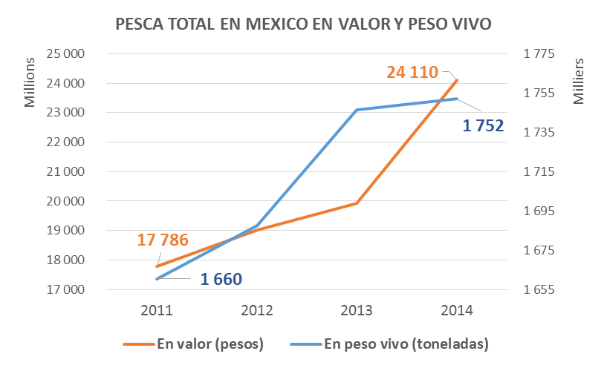
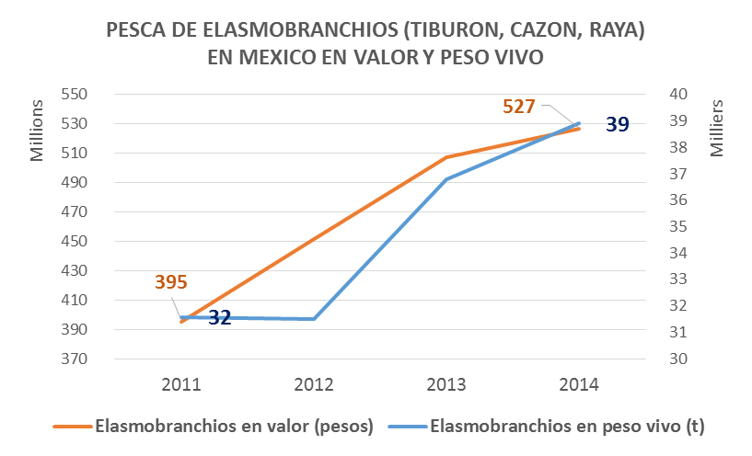
The context of fishing in Mexico
+36%
+33%
+23%
+6%
The fishing industry represents $24 bln pesos a year. It is growing faster in value (+36%) than in volume (+6%)¹
The elasmobranches is a market of $527M pesos a year or 2% of the total of catches. ¹
Elasmobranches are fished at faster rate in volume (+23%) than the total industry (+6%). ¹
According to COBI, illegal fishing could represent up to 56% of the official figures. ²
¹
Notes:
Sources:
1. CONAPESCA, base de datos de produccion annuario 2011, 2012, 2013, 2014.
2. COBI. La pesca ilegal e irregular en méxico: una barrera a la competitividad

Slide 12
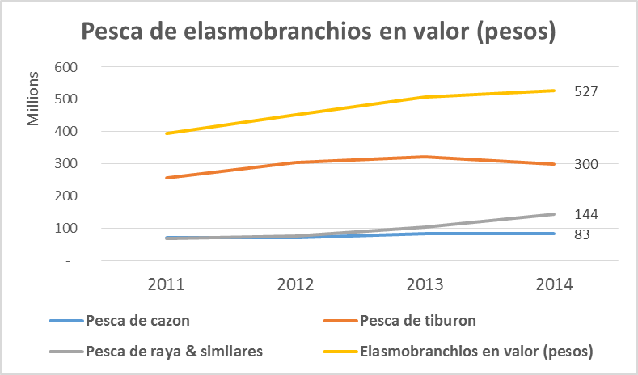
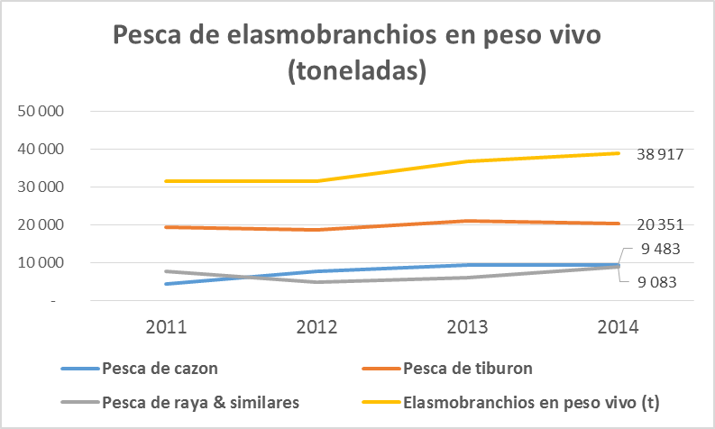
The context of elasmobranches fishing in Mexico
+33%
+17%
+23%
+5%
+109%
+114%
+19%
+18%
Between 2011 and 2014 the elasmobranchios fishing has increased by 33% in value and 23% in volume.¹
The value of rays has increased by 109% in the same period. ¹
The volume of cazon (small sharks) has increased by 114% in the same period. ¹
NB: for Conapesca a Cazón is “Cualquier especie de tiburón que sea menor a 1.5 m de longitud total aproximadamente, incluyendo adultos de especies pequeñas o juveniles de especies grandes.”
¹
Notes:
Source:
1. CONAPESCA, base de datos de produccion annuario 2011, 2012, 2013, 2014.

Slide 13
The context of fishing in Baja California Sur
EVOLUTION OF FISHING VOLUME IN THE PAST 10 YEARS¹
EVOLUTION OF FISHING VALUE IN THE PAST 10 YEARS¹
-9%
+76%
B.C.S IS CENTRAL IN MEXICO’S FISHING INDUSTRY
In Mexico in 2013 B.C.S. ranks:
4th in terms of fishing volume with almost 10% of the total (157 000 tons). It account for 7% of total value (MXN$1,4bln) ¹
3rd in terms of shark fishing with 15% of the total ¹. Sinaloa and Baja California rank 1st and 2nd.
EMPLOYEMENT CONSEQUENCES
Between 2004 & 2009, an additionnal +38,7% persons joined the fishing industry.³
In 2009 there were 8,820 fishermen in the state. 42% of them are in Comondu and 35% in Mulegé. ³
Despite the obvious effects of overfishing in B.C.S in the past 10 years (lower volue, higher value) fishermen are even more numerous globally degradating their living conditions
¹
Notes:
Sources:
1. CONAPESCA, Anuario Estadistico De Acuacultura Y Pesca 2013.
2. CONAPESCA, base de datos de produccion annuario 2011, 2012, 2013, 2014.
3. Eric Horacio Rubio Fierro-Bandala

Slide 14
The context of elasmobranchios fishing in B.C.S
0%
-14%
+73%
+127%
+54%
+147%
-30%
+88%
In 2013 elasmobranchios account for 3% of the total volume and value of fishing in B.C.S ¹
Between 2011 and 2014 their volume is stable (0%) but their value exploded (+73%) ¹
They rank 8th among species fished in B.C.S. and generate a total value of MXN$75 mln ¹
The value of elasmo fishing in B.C.S (including +56% of illegal fishing) is around MXN$117 mln / year
It is realistic that eco-tourism in B.C.S reaches such an amount to offer an alternative to elasmo overfishing
However that would require a precise matching of eco-tourists and elasmo fishermen
¹
Notes:
Source:
1. CONAPESCA, base de datos de produccion annuario 2011, 2012, 2013, 2014.

Slide 15
The fishing industry in Comondu
In 2013, Comondu represents:
- 70% of B.C.S total fishing industry volume (107 434 tons)¹.
- 30% of B.C.S total fishing industry value (MXN$ 412 mln)¹.
Fishing acitivies are concentrated mainly in PSC and Adolfo Lopez Mateos.
3,735 fishermen in Comondu 2009 (+52% vs 2004) ²
Comondu is focused on sardines fishing, especially in Mag Bay. They represent high volume & low value.
¹
Notes:
Sources:
1. COMONDU Información Estratégica 2014. Gobierno Del Estado De Baja California Sur Secretaria De Promoción Y Desarrollo Económico Dirección De Informática Y Estadística
2. Eric Horacio Rubio Fierro-Bandala

Slide 16
The fishing industry in Puerto San Carlos
Non-official figures
Population in PSC in 2015¹ | 6 489
% of active population in PSC in 2009 ² | 45%
% of active population dedicated to fishing in 2009 ² | 46%
# of fishermen in Puerto San Carlos in 2015³ | 1 373
Average value generated by fisherman in B.C.S in 2009 (pesos) ³ | 128 978
Total value generated by fishermen in PSC in 2015 (pesos) ³ | 177 054 730
In 2009, 67 large boats operate in Bahia Magdalena. ² → They mainly fish shrimps, tuna, sardines and anchovies.
→ Only 4 are based in PSC, fishing sardines & linked to local plants²
→ The rest is exported outside PSC.
3633 pangas operate in Bahia Magdalena. ² → Only 1000 are based in PSC. ²
→ They focus on coastal fishing (clams, crabs, fish…)
3 local processing plants operate in PSC the biggest being Conservera San Carlos, S.A. de CV
AFC’s estimation ³
99% of families in Puerto San Carlos depend at least partly on fishing revenues. ⁴
The fishing industry in PSC estimated at around MXN$180 mln represents about 80% of total local revenues. ²
The largest part of PSC fishing revenues is generated by small coastal boats vs deep sea fishing that is exported.
A large part of the fishing value generated in Magbay never impacts PSC. Many non local boats operate here.
Notes:
1. COMONDU Información Estratégica 2014. Gobierno Del Estado De Baja California Sur Secretaria De Promoción Y Desarrollo Económico Dirección De Informática Y Estadística
2. Eric Horacio Rubio Fierro-Bandala
3. AFC calculation in Excel doc « Analysis of tourism & fishing industries in PSC_Key data” in “pesca en PSC” sheet
4. Field interviews

Slide 17
3 main sources for shark fishing in Puerto San Carlos
Non-official figures
Estimated volume fished / year¹
Estimated economic value (pesos) ¹
50 pangas based in PSC local community operating only in high season (August)
8 000 sharks
280 tons (peso vivo)
Value generated = $ 4,3 mln / year
Fisherman monthly revenue = $10 000
Around 150 fishermen
50 pangas coming from La Ventana and based in fishermen camps in Magbay (Cabo Tosco, Punta Arenas, Punto Mateos) operating from August to February
56 000 sharks
1 680 tons (peso vivo)
Value generated = $ 37,8 mln / year
Fisherman monthly revenue = $17 000
Around 150 fishermen
X large boats coming from Ensenada by road or sea
???
???
Fishermen PSC don’t feel concerned by shark fishing and mostly refer to the shark fishermen camps around MagBay.
Notes:
1. AFC calculation in Excel doc « Analysis of tourism & fishing industries in PSC_Key data” in “pesca en PSC” sheet

Slide 18
4. Analysis of the tourism industry in P.S.C.

Slide 19
Key figures about tourism in Baja California Sur (B.C.S.)
 | Los Cabos¹ | La Paz – Loreto¹ | Puerto San Carlos
Total visitors/year. | 1,3M visitors. | 375 000 visitors | 5 990 visitors²
% of tourism market share in B.C.S. | 80% | 20% | NA
% of foreigners among total visitors | 75% | 15% | 40%²
% of nationals among total visitors | 25% | 85% | 60%²
Attraction of foreign visitors in B.C.S. | 95% | 5% | NA
Average length of stay | 5 days | 2 days | Nationals usually don’t stay overnight while foreigners do (1 night on average) ³
Occupancy rates of hotel rooms | 60% | La Paz: 50% - Loreto: 25% | Around 30% only during whale season (jan-march) ³
Evolution of tourism since 2008 | Stable. In 2014, tourism fully recovered its level of 2008. | Suffered more from 2008 crisis. In 2014, La Paz almost recovered its 2008 level, while Loreto was only at 55% of its 2008 level. | Strong decrease since 2008. ³
B.C.S does not have an organic growth rate of tourism and is still recovering from a strong decrease after 2008.
The structural differences of tourism between Los Cabos & La Paz-Loreto need to be taken into consideration to be able to grow tourism in PSC.
Notes:
SECTUR. Compendio Estadístico del Turismo en México 2014
Eric Horacio Rubio Fierro-Bandala’s Thesis
Deduction from on the ground interviews – absence of official figures

Slide 20
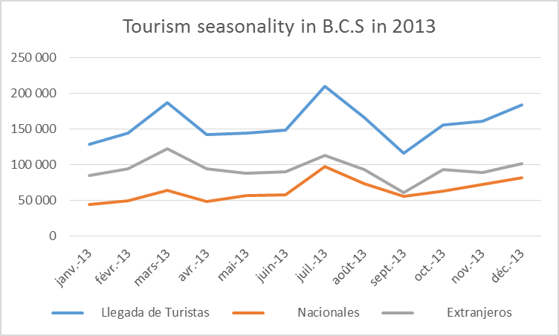
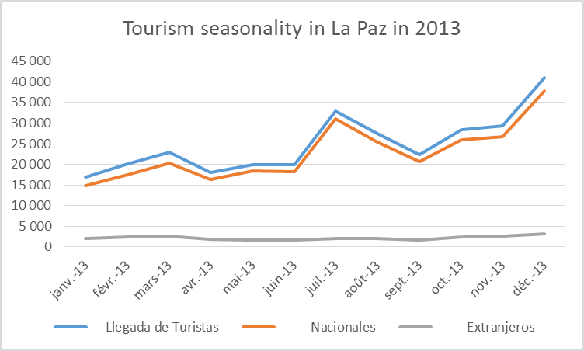
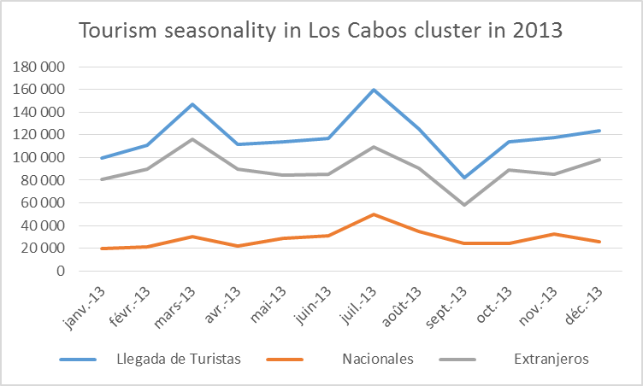
P.S.C. hardly benefits from B.C.S tourism
Only 2% of the total number of tourists visiting B.C.S. go to Comondú ¹
With “only” 5 990 tourists a year, PSC is much less attractive for tourists than Adolfo Lopez Mateos for structural reasons and tourism in PSC has strongly decreased since 2008 ⁴
Most of tourists coming to PSC come on their own by car and not with an agency. ³
Tourism in PSC lasts only from mid-January to mid-March while BCS also experiences peaks of tourism in December and in July²
→ There is a clear missed opportunity on tourism for PSC
Notes:
Source: Eric Fierro-Bandala’s thesis
Source: on-the ground interviews and SECTUR figures’ analysis
Deduction from on the ground interviews – absence of official figures
Documento enviado por el SECTUR "ESTADISTICA BALLENA GRIS." SEMARNAT, Delegación Federal en Baja California Sur.

Slide 21
P.S.C. visitors’ are not spending either time or money in town
Non-official figures
Best case scenario of the expenses of a visitor in P.S.C. (pesos) ¹
Whale watching | $900
Breakfast | $110
Dinner | $270
Hotel | $900
Length of stay | 1
Total for 1 day | $3294
60% of tourists visiting PSC are nationals² and nationals’ average budget is only MXN$ 504 per person per day³ (versus MXN$ 3600 for foreigners) ⁴
If we take an optimistic scenario of a foreigner spending the night in P.S.C., doing the whalewatching and taking 2 meals in restaurants, the total spending is MXN$ 3294
In Los Cabos, the average spending is MXN$11 880⁵. This can be justified because visitors stay in average 5 days and that they are ready to spend more in everything: hotel, restaurants, tours…
The levers to increase the value of tourism in PSC is to increase the value of the tours (pricing, quality service) and to ensure that tourists stay longer and spend more.
There is a key need to diversify the activities proposed in Puerto San Carlos to increase the amount of revenues generated by tourism.
Notes:
Source: on-the ground interviews
Eric’s thesis
Encuesta nacional de gasto turistico 2013
Info sent by the SECTUR
AGENDA DE COMPETITIVIDAD DEL DESTINO TURÍSTICO DE LOS CABOS – SECTUR - 2014

Slide 22
Why PSC should not try to compete with Puerto Lopez Mateos?
 | Puerto Lopez Mateos | Puerto San Carlos
Population in 2010¹ | 2 212 | 5 538
Nb of visitors in 2013² | 9 577 | 5 990
Nb of whales in 2013² | 402 | 240
Nb of restaurants in 2014³ | 8 | 6
Nb of hotels in 2014³ | 3 | 7
Population benefiting from tourism ⁴ | NC | 30 families a few weeks per year
Puerto Lopez Mateos benefits from structural advantages compared to PSC:
more whales and they are closer from the shore (meaning less time, less expenses to watch them)
more committed community because no economic alternative, smaller population and greater sense of community leading to better organization and greater mobilization
P.S.C. can’t compete with P.L.M. on « whale watching » so it needs to offer something different, positioning more the bay as a whole (birds, dunes, mangrove and Pelagic Life)
Notes:
Source: Comondu Informacion Estrategica 2014. Gobierno del Estado de B.C.S. Secretaria de promocion y desarollo economico.
Source: Documento enviado por el SECTUR "ESTADISTICA BALLENA GRIS." SEMARNAT, Delegación Federal en Baja California Sur.
Source: Documento enviado por el SECTUR "P.S.T - Mpio. Comondú."
Source: on-the ground interviews

Slide 23
Tourism perceived by the inhabitants of Puerto San Carlos
Only a very limited number of families are curently benefiting from tourism in PSC
Tourism represents only 5% of the total economic revenues of PSC¹
81% of those interwied by Eric stated that they were not benefiting from tourism revenues in PSC¹
Less than 30 families own all tourism-related businesses: whale whatching tours, hotels and restaurants²
Most fishermen consider tourism as potential additional revenues but are not willing to stop fishing to focus only in tourism
63% of interviewed fishermen in PSC consider more interesting to focus on tourism in the 3 months when they are not fishing¹
Only 37% of interviewed fishermen state that they are willing to focus on whale watching and alternative tourism all year long¹
In the next years, tourism will only be a source of complementary revenues, but not an alternative to fishing
It makes it harder to determine the critical volume of tourism necessary to have a « real impact » on fishing
Notes:
Source: Eric Fierro-Bandala’s thesis
Source: on-the ground interviews and SECTUR figures’ analysis

Slide 24
Main take-aways on tourism in PSC
Non-official figures
Value of the tourism industry¹
Key figures about tourism in PSC
# promedio de turistas por ano | 5 990
% de turistas nacionales | 60
gasto promedio de un turista nacional (pesos) | 504
% de turistas extranjeros | 40
gasto promedio de un turista extranjero (pesos) | 3222
Derrama del turismo en PSC (pesos) | 9,531,288
% del turismo en la economia de PSC | 5%
# promedio de turistas por ano | 5 990
# lanchas con permisos de avistamiento de ballenas | 44
# hoteles | 8
# empleados por hotel | 4
# restaurantes | 11
# empleados por restaurante | 3
# personas que trabajan en el turismo (en temporada) | 109
# promedio de permanencia | 0,8
precio promedio de una noche en un hotel | MXN$900
precio promedio de una comida en un restaurante | MXN$216
precio promedio de un tour de avistamiento de ballenas | MXN$900
# dias por ano de temporada turistica alta | 60
Tourism does not bring a lot of money into the town and this money benefits to a very limited number of people
Notes:
3. AFC calculation in Excel doc « Analysis of tourism & fishing industries in PSC_Key data” in “pesca en PSC” sheet

Slide 25
5. How to develop ecotourism in Puerto San Carlos?

Slide 26
How to evaluate the potential of tourism developement in PSC?
Fishing vs tourism in PSC
 | Tourism | Fishing
Total revenues / year | MXN 9 million¹ (USD 500 000) | MXN 177 million³ (USD 9,8 million)
% of activities in PSC | 5%² | 80%²
Nb of people working | Part-time: 109¹ | Full-time 1373³
We voluntarily did not measure the potential of developement of tourism in Magbay as it highly depends on community engagement + we believe Pelagic Life has more important challenges to adress for now (part 6). However, if we were to did, we would proceed with the following steps:
Set an yealry objective of tourists coming to PSC to reach
Define the right levers to reach that objective and especially identify relevant local allies
Evaluate the consequences on the local economy (tourism & fishing)
Notes:
Figure given by M. Cota, Delegado al turismo and aligned with AfC calculation in Excel document, page « Turismo en PSC »
Source: Eric Fierro-Bandala’s thesis
AfC Calculation in Excel document, page « Pesca en PSC »

Slide 27
Quick overview of potential alternative ecotourism activities
Actvity & ranking | Upsides | Downsides | Prices in BCS
Bird watching +++ | The bay is a unique place for birdwatching Could add great value to the existing offer (economic but also environmental value) | Training needed | Los Cabos 4 hours for $77 5 hrs birding and a mini pelagic tour for $99
Stand Up Paddle ++ | Very easy, No training needed, Low investment needed, The bay is a great environment | No big added value neither for the community or the ecosystem | Los Barriles / La Ventana $20-$25/hour $60-$75/day Loreto: $30/day
Kayaking ++ | Very easy, No training needed, Low investment needed, The bay is a great environment | No big added value neither for the community or the ecosystem | Loreto: $55/day La Paz $45/day for a single $65/day for a double shuttle to Isla Espiritu: $150
Kitesurfing + | The bay could be a great spot to kitesurf | Training and investment needed | Los Barriles: rental : $125/day classes: around $75/hour
Mountain biking + | Amazing landscapes No training and little investment needed | Only 1 identified trail on Isla Marguerita which is not easily accessible | La Paz: $60- $75 for 6-8 hours tour
Notes:
Sources
Bird watching
http://www.birdingpaltours.com/MexicoItinerary.htm#tour5
http://www.birdingloscabos.com/birding-los-cabos-area
http://wingsbirds.com/tours/mexico-baja-californias-cape-region/
SUP
Los Barriles: http://www.exotikite.com/stand-up-paddle-board.html
Baja California Sur: http://www.yumping.com.mx/paddle-surf/baja-california-sur
Loreto: https://seakayakbajamexico.com/rentals/sup/
Kayaking
Loreto: https://seakayakbajamexico.com/rentals/sit-on-top/
La Paz : https://www.kayakbaja.com/rentals.php + http://baja.com/la-paz/activities/kayak-windsurf-jetskis-sailboats-waverunners-rental/
Kitesurfing
http://www.exotikite.com/kiteboarding-lessons.html
Mountain biking
http://www.katuntours.com/daytours.html

Slide 28
Quick overview of potential alternative ecotourism activities
Actvity & ranking | Upsides | Downsides | Prices in BCS
Spearfishing ++ | Magda bay area is very rich and a great place for spearfishing Directly linked to the sea | Training needed – local captains don’t like to go into the water Kills fishes may thus may not be aligned with Pelagic Life conservation missions | La Paz $350 US dollars for 2 px La Ventana $210.00 USD per day/per diver Cabo San Lucas NA because website in maintenance: http://spearfishingbaja.mx/
Sport fishing ++ | Very easy as some captains are already doing it (Zarabia, Enrique) No training needed The bay is very rich | Kills fishes may thus may not be aligned with Pelagic Life conservation missions (even with catch & release) | La Paz: $350.00 USD per day Cabo San Lucas They don’t give their prices on their website, you have to contact them to get a quote
Notes:
Sources
Spearfishing
La Paz: http://www.bajamosquitofleet.com/spearfishing/
La Ventana: http://seasniperbaja.com/contact-us/
Cabo San Lucas: http://spearfishingbaja.mx/
Sport fishing
Baja California Sur: http://www.yumping.com.mx/pesca/baja-california-sur
Puerto San Carlos:
http://www.hotelbrennan.com.mx/web/index.php%3Foption=com_content&task=view&id=20&Itemid=35.html
http://magbaytours.com/fish-tour-new/
La Paz:
http://golapaz.com/pesca-deportiva/
Cabo San Lucas:
http://www.piscessportfishing.com/
http://picantesportfishing.com/

Slide 29
6. How can Pelagic Life ensure an impact in the community and on sharkfishing?

Slide 30
Feedbacks from the community
“Aquí como están, no van a cambiar nada. Trabajan con los que no lo necesitan y hablan del impacto en el pueblo pero por el momento no hay, y ya son 4 años que trabajan aquí.“
Enrique, capitan de ballena que trabaja con el Brenann
“Por ejemplo, había un proyecto con las tortugas muy bonito, cuando los pescadores se dieron cuenta que este proyecto se desarrollaba en modo privado, sin compartir el dinero, blocaron todo, cerraron todas las puertas y ahora el proyecto esta cuasi muerto.”
Dona Maru, duena del Alcatraz
“Aquí nunca va a ser un lugar turístico porque no podemos luchar contra la pesca.” Crispin, capitan de ballena
“Como va a acabar con Pelagic Life? Voy a ir a la Paz o a Los Cabos para obtener el apoyo de otra organización para abrir un shark diving shop.” Fito Gonzales, dueno del Mar y arena
“Si no trabajas con los tiburoneros, lo que va a pasar es que ellos van a irritarse porque van a trabajar en las mismas zonas. Es seguro que vas a perturbarlos.” Crispin, capitan de ballena
“Tu nos me puedes decir dónde ir, el mar es de todos. Y además, si Pelagic quiere tener un impacto positivo, tienen que aprendernos. Tienen que convivir con el pueblo” Angel y Maty, guia de buceo
“Si Pelagic Life quiere ser agentes del cambio, tienen que compartir el trabajo”
Dona Maru, duena del Alcatraz
“Les veo mucho en el hotel y nunca me han preguntado nada”
Enrique, capitan que trabaja con el Brenann
« Hé escuchada de Pelagic Life, es el proyecto de los Zarrabia. Y los Zarrabia son muy cerrados.
Dona Maru, duena del Alcatraz
“Sé que no hay muchos turistas en PL todavía pero con el poco que tienen, pueden empezar a involucrar un tiburonero para demostrar a la comunidad que hay potencial.” Crispin, capitan de ballena

Slide 31
3 key principles to launch a community-project
1. WHETHER THEY ARE BENEFICIARIES OR CLIENTS, COMMUNITY MEMBERS’ ENGAGEMENT IS KEY TO THE SUCCESS OF THE PROJECT.
2. A BAD BUZZ GOES 100 TIMES FASTER THAN A GOOD BUZZ AND IS MUCH HARDER TO MITIAGE → KEEP LISTENING TO WHAT PEOPLE SAY ABOUT YOU AND KEEP CHANGING THE PROJECT
3. LEARN TO LISTEN TO WHAT MATTERS THE MOST AMONG ALL THAT IS SAID
90% of
INDISTINCT CHATTER coming from:
Jealousy
Boredom
Rivalry
10% of
USEFUL COMMENTS

Slide 32
Analysis of Pelagic Life’s current situation in PSC
Strengths Public awareness efforts seem to work well (Documentary, Facebook…) Number of expeditions is increasing Good relationship with shark experts | Weaknesses Absence of clear strategy Absence of local allies, beyond the Zarabias Communication that does not match with reality in PSC
Opportunities Not too late to change current situation Could leverage partnership with scientific experts + local school (CETMAR) If part of Pelagic Life team is based in Los Cabos, opportunity to spend more time in PSC | Threats Growing dissatisfaction in PSC Many obstacles to tourism development in PSC, that PL can overpass alone Emerging competition that could put at risk the whole activity (security)

Slide 33
Pelagic Life at a crossroad: time to choose and focus
What is today?
A FRIENDS’ PROJECT OF UNDERWATER PICTURES?
A BUSINESS?
A COMMUNITY PROJECT?
A strong media recognition and coverage | PL already generates revenues (expeditions, products…) | Already working with fishermen in PSC Generating 1st revenues for the community
Define better how the high level of communication positively impacts the conservation purpose | Create stable streams of revenues Refine the offer and improve client service | Listen to the community Work with shark fishermen Define a clear impact map (objectives, indicators…)
WHAT WORKS?
WHAT NEEDS TO BE IMPROVED?

Slide 34
AfC recommendations
Puerto San Carlos is an ambiguous location to work in because:
Either you have a direct impact on shark fishermen but indirect impact on the village
Or you have a indirect impact on shark fishermen but a direct impact on the village
Pelagic Life reputation is at stake in the village. Today is deception. Tomorrow could be worse.
Potential high security risk of other organizations starting to launch « nado con tiburones »
Start by spending more time in PSC and just listen to what people say.
4 questions to be dealt with in priority
Which model? Business or community project.
Which impact? Direct or indirect on shark fishermen or public awareness. A useful tool: Theory of change.
Which type of impact? Strong impact on few families or light on many.
Which location? Puerto San Carlos or elsewhere. Mitigate the risk inherent to PSC.
Start thinking of an economic hybrid model
Ex: create 1 company generating profit to nurture the NGO of awareness and images?
Context Analysis
Recos

Slide 35
BACK UP

Slide 36
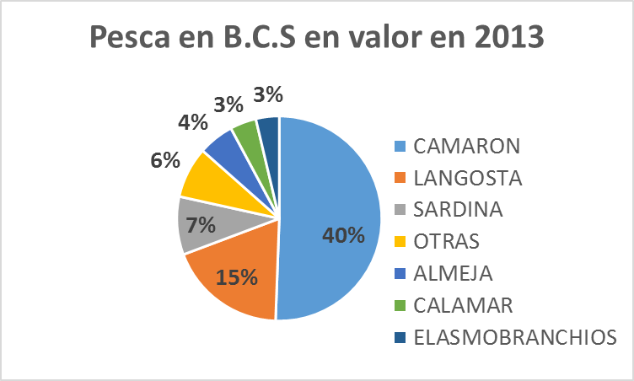
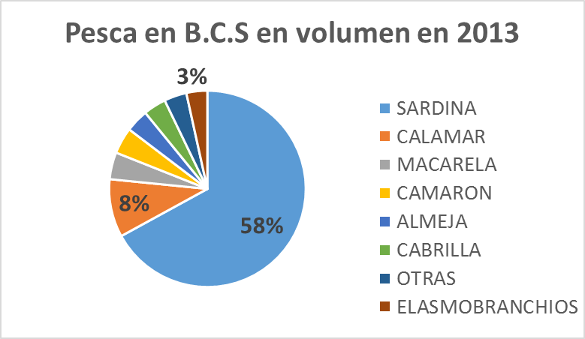
Fishing by species in Baja California Sur
TOTAL MXN$ 1,4 bln
TOTAL 157 000 tons
Source: CONAPESCA, base de datos de produccion annuario 2013
Source: CONAPESCA, base de datos de produccion annuario 2013
Notes:
1. CONAPESCA, Anuario Estadistico De Acuacultura Y Pesca 2013.

Slide 37
Fishing of sharks and cazon in Mexico over the past 10 years in volume
El Tiburón y Cazón por su volumen se encuentran posicionados en el lugar 9 de la producción pesquera en México; sin embargo, por su valor, los encontramos en el lugar 8. La tasa media de crecimiento anual de la producción en los últimos 10 años es de -0.75%.
Notes:
Fuentes:
- CONAPESCA, Anuario Estadistico De Acuacultura Y Pesca 2013.

Slide 38
Focus: Whale watching & shark swimming captain’s business model
Business model de un capitan de lancha turitisca (en USD)
Inversion¹ | costo de una lancha | 7000
 | precio de un motor | 13000
 | costo del otro equipamiento | 3000
 | permiso de avistamiento² | 8500
Ingresos y gastos/ballenas¹ | ingresos promedio por 1 viaje | 200
 | gastos por 1 viaje | 66
 | # promedio de viaje por ano por lancha | 60
 | gananza por el capitan por un dia de avistamiento | 134
 | ingresos promedio por 1 ano de avistamiento | 8040
Ingresos y gastos/Pelagic¹ | ingresos promedio por 1 viaje | 305
 | gastos por 1 viaje | 85
 | # promedio de excursiones por ano | 12
 | # promedio de dias por ano por lancha | 36
 | gananza por el capitan por un dia | 220
 | ingresos promedio por 1 ano de excursiones | 7920
Notes:
Source: Interviews with captains such as Gabino, Enrique and Crispin
Source: Eric Fierro-Bandala’s thesis

Slide 39
Useful contacts
BIOMAR | La Paz | El Programa de Conservación y Uso Sustentable de la Biodiversidad Marino-Costera en el Golfo de California | Fernando García Flores | Jefe de Equipo Proyecto Áreas Naturales Protegidas y Turismo Sustentable en el Golfo de California | fernando.garcia@gfa-group.de (+52 1) 749 850 00 80
CETMAR | Puerto San Carlos | Centro de estudios tecnologicos del Mar | Martin Gonzalez Garibay | Director | gongarm1@hotmail.com cetmar31@hotmail.com
PELAGIOS KAKUNJA | La Paz | Organización sin fines de lucro, creada en 2010 por investigadores y científicos mexicanos. Se centra en la investigación de especies de tiburones y otros organismos de aguas abiertas, con la finalidad de generar información para el manejo regional y la implementación de estrategias de conservación. | Armando Lozano Horcasitas | Biologo marino miembro de la red Pelagios | maarexperiences@gmail.com

Slide 40
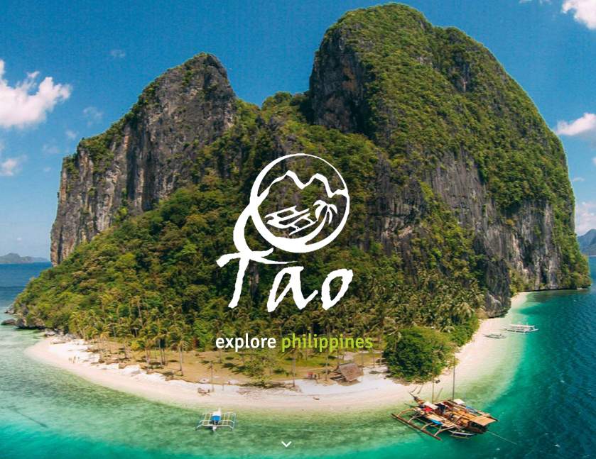
A case study for inspiration: Tao in the Philippines
Concept? 5 days boat trip around remote islands with local guides very well trained.
How? Local fishing boats adapted to tourism services and nights in camps that they built next to fishing villages. No overall comfort but great guides, great food, great client service.
Organization? For-profit tourist company with a strong social DNA and local impact
http://taophilippines.com/open-group-experience/
TAO Experiences
“We are the islanders, we are your hosts, proud of our way of life and proud to welcome you as our guests. Join us on a journey to discover the raw beauty of island life in the Philippines last frontier.”
Notes:
Sources

